Slide 1

A Regression Story: Building a Price Predictive Model for Cars
Neshat J. Heravi
GitHub: Neshat-JH
10/13/2021

Slide 2
Introduction
The cars prices have fluctuated in the past year or so due to the pandemic aftermath. The incentive is to create a predictive model based on recent data so that buyers have a more realistic information about car prices.
Objective
The objective of this project is to build regression predictive models for car prices based on their features. The model with best evaluation metrics and highest accuracy will be selected for use.
Goal
The goal is to help Pacific Northwest car buyers to have a more realistic idea of the prices amid recent price fluctuations.

Slide 3
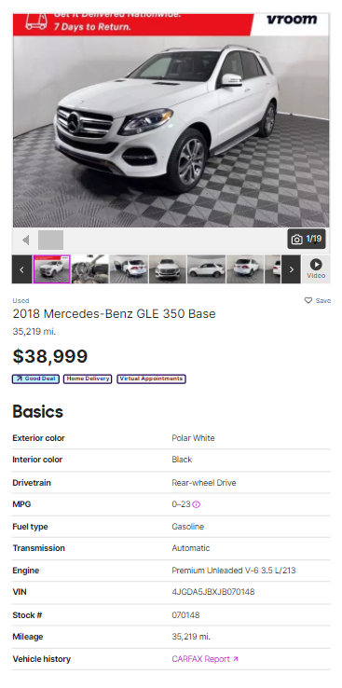

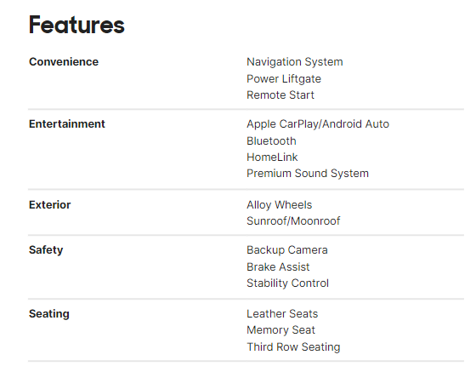
Data
Data is scraped from cars.com website using BeautifulSoup Python library.
Data includes Seattle and Portland cities and areas within the 30 miles radius.

Slide 4
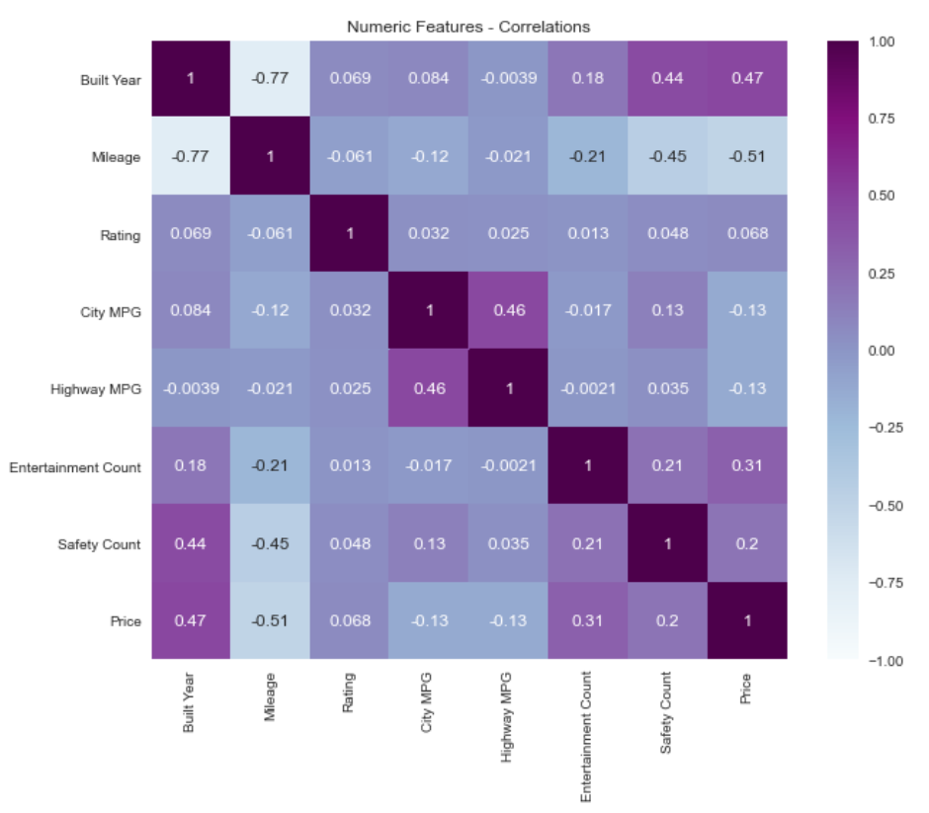
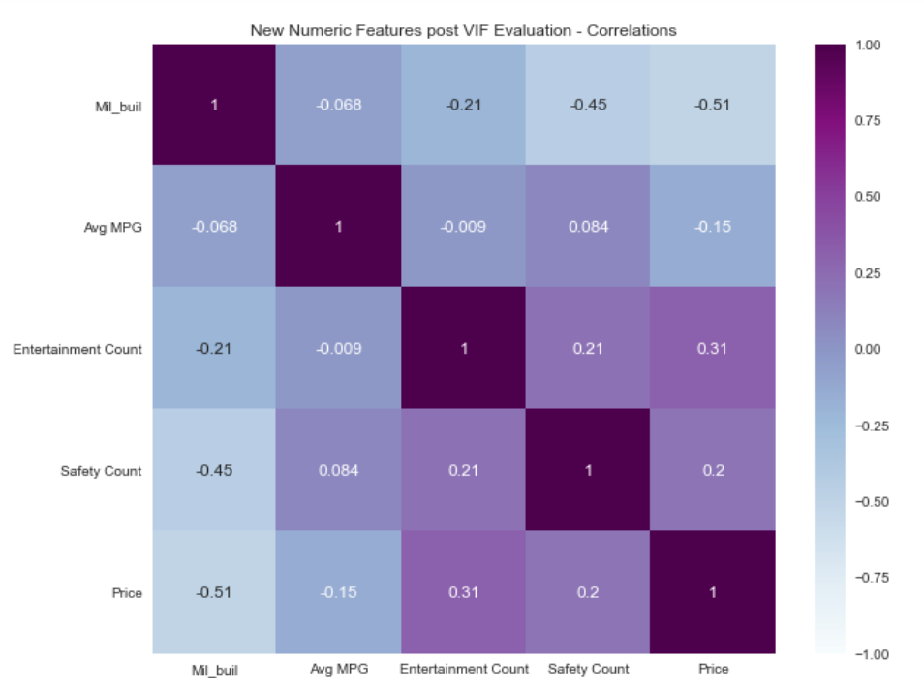
Methodology
Data cleaning:
Disintegrating some columns: Built Year, Make and Model from Name
Detecting and handling missing data and outliers
Exploratory Data Analysis (EDA):
Looking into feature correlations, VIF, pairplots etc.
Understanding the transformations needed to make data suitable for regression model
Building Models:
Creating different regression models.
Using cross-validations, and using evaluation metrics to select the final model

Slide 5
Regression Models: Evaluation Metrics
Base Linear Regression (numeric features only):
R² Training set: 0.35
R² Test set: 0.37
MAE: 8,940.20
RMSE: 11,545.34
Linear Regression (post log transformation of target):
R² Training set: 0.45
R² Validation set: 0.47
R² Test set: 0.45
Polynomial Regression:
R² Training set: 0.55
R² Validation set: 0.55
R² Test set: 0.54
Lasso Regression:
R² Training set: 0.87
R² Validation set: 0.85
Ridge Regression:
R² Training set: 0.88
R² Validation set: 0.85
Gradient Boosted Regressor:
R² Test set: 0.80
XGBoost Regressor:
R² Training set: 0.95
R² Validation set: 0.95
R² Test set: 0.90
MAE: 3,323.50
RMSE: 4,682.70

Slide 6
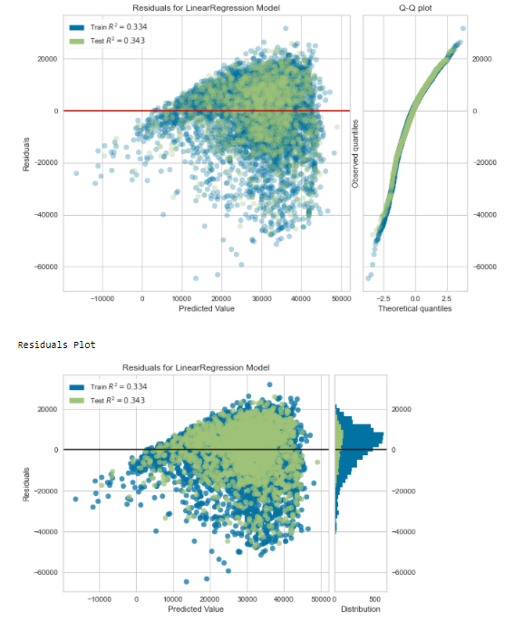
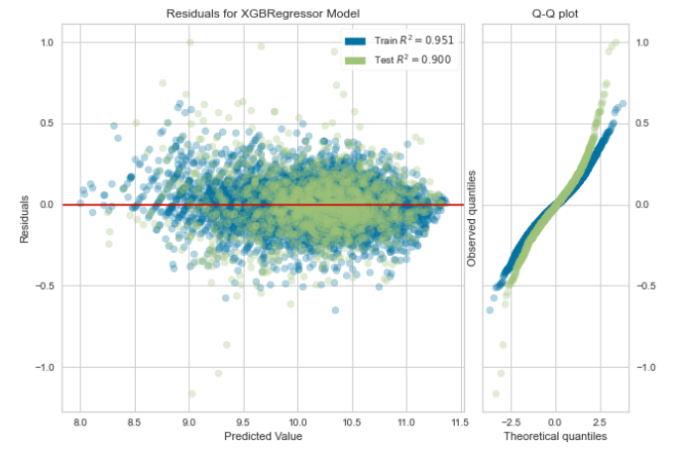
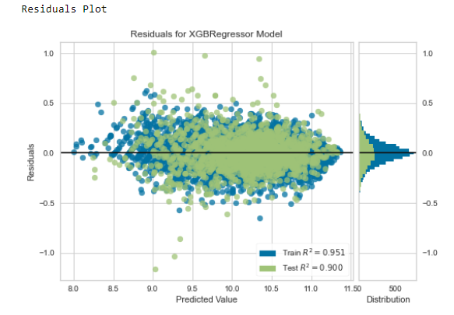
Regression Models: Residuals Comparison
Residuals for Linear Regression
Residuals for XGBoost Regressor

Slide 7
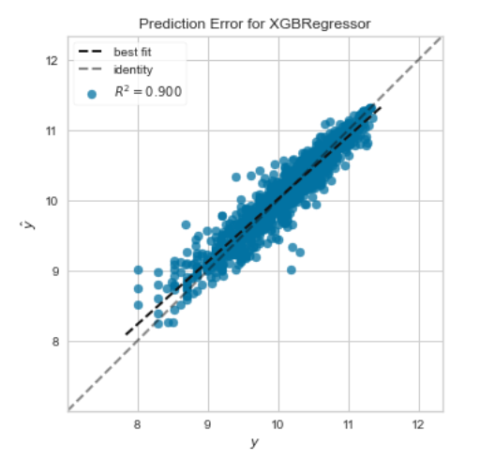
Conclusion
The objective of this project was to built and select the most accurate regression model to predict cars’ prices. Thus, based on the evaluation metrics the XGBoost Regressor is the most accurate model with R^2 score of 90% on the test set.

Slide 8
Future Works
More thorough data cleaning is suggested; specially handling the outliers will result in more accurate models
A more detailed hyper-parameter tuning can increase the accuracy of Gradient Boosted and XGBoost regressors. (using GridSearch)
Data from multiple sources can increase the reliability and also generalization of the models.

Slide 9
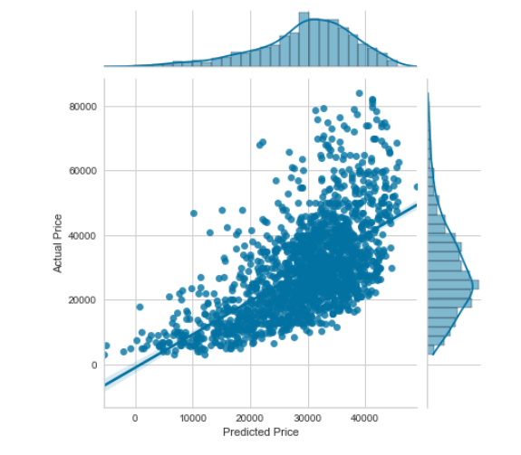
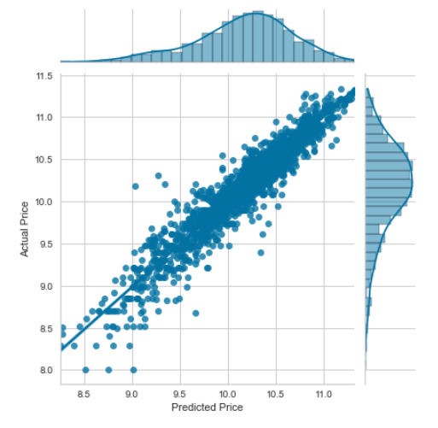
Appendix
Jointplot of Base Model: Linear Regression
Jointplot of Final Model: XGBoost Regressor

Slide 10
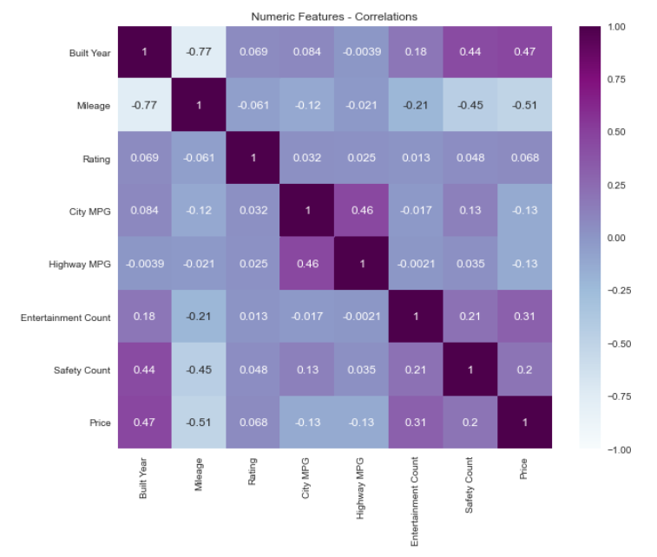
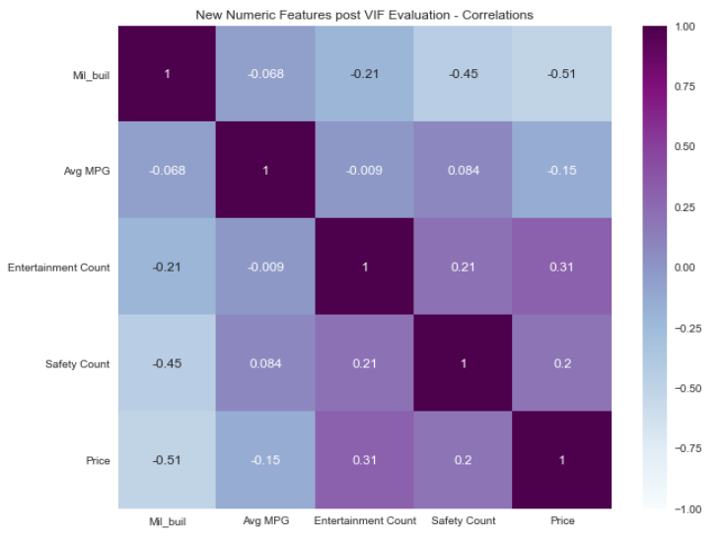
Appendix: Correlation of Numeric Features

